Slide 1
www.ECOAWARE.com
Group 7: Anne-Marie Akoh, Nicholas Buckley, Andrew Donohue and Izabel Miminoshvili
Professor Dunn
CS 146-A
December 9, 2021

Slide 2
High-Level Description
Using a combination of html, css, and js, our complete website, ECOAWARE, performs just as anticipated. We have created multiple features to ensure that there is something for every user to enjoy. As a topic that affects all of us worldwide, everyone can find familiarity at www.ECOAWARE.com. The Home page welcomes arriving users, displays some of our favourite images, and references the creators - us. For those seeking information and empirically supported data regarding the environment, the Information Page supplies digestible content. Regarding a more monetary option, ECOAWARE allows users to both make donations to non-for-profit organizations and personally shop for eco-friendly products both available through the Donations and Purchase tabs respectively. Additionally, users may input their desired username and post their corresponding comments to the Spread The Word page where our website hosts a more social and interactive environment. Overall, ECOAWARE is a fun yet educational website source dedicated to a universal cause and is friendly to people of all ages.

Slide 3
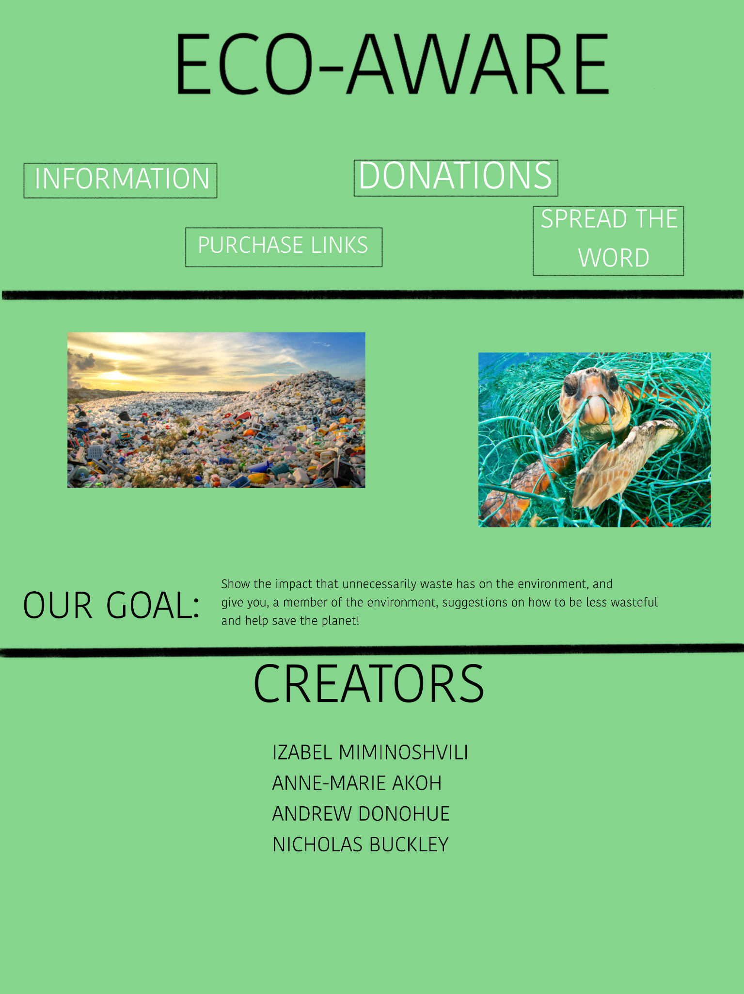
Original Sketch

Slide 4
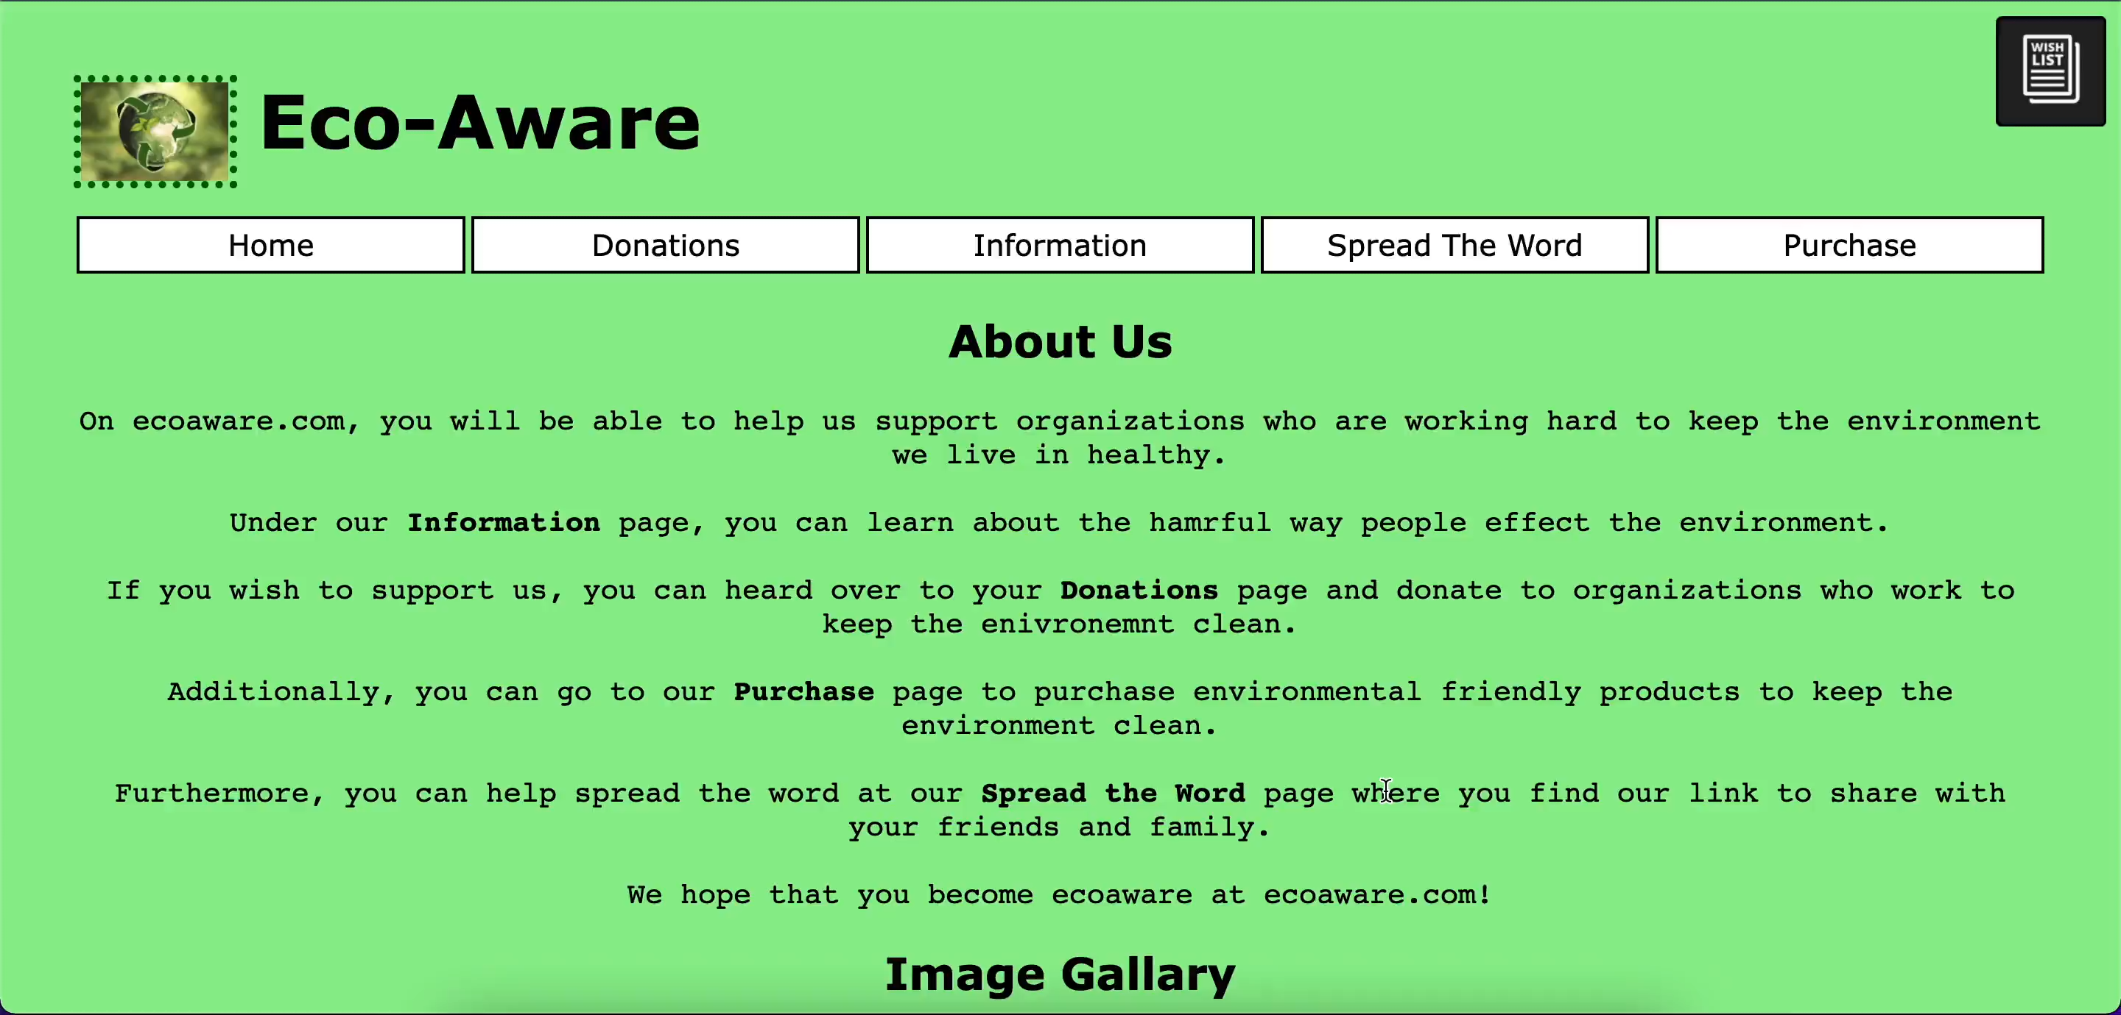
Short Video of Functionality

Slide 5
HTML Elements
For our website, we used many varying html elements that suited the different types of content we wanted to display on our different pages. For text, we mostly used paragraph <p> and header <h> tags in order to divy up the different types of text we wanted. Additionally, we used ordered list <ol> tags to organize our info and display it nicely. Furthermore, we used many division <div> tags in order to organize the html. For navigation between our different pages and external sites, we used the hyperlink <a href> tag with the <nav> tag to organize them together.
For our many images we used the <img> tag and for videos we used the <video> tag.
For our interactive sections of the website, we used the <button> tag and linked javascript functions to them which allow for extra functionality.
Overall, we tried to use the most efficient and useful html elements to make sure our code and site were organized and easy to follow.

Slide 6
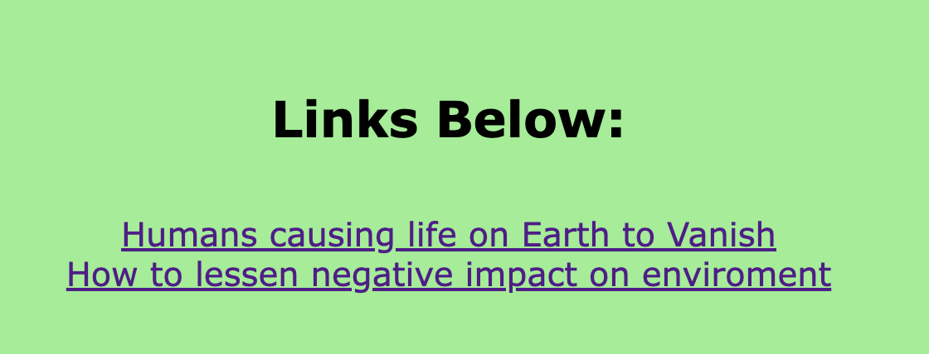
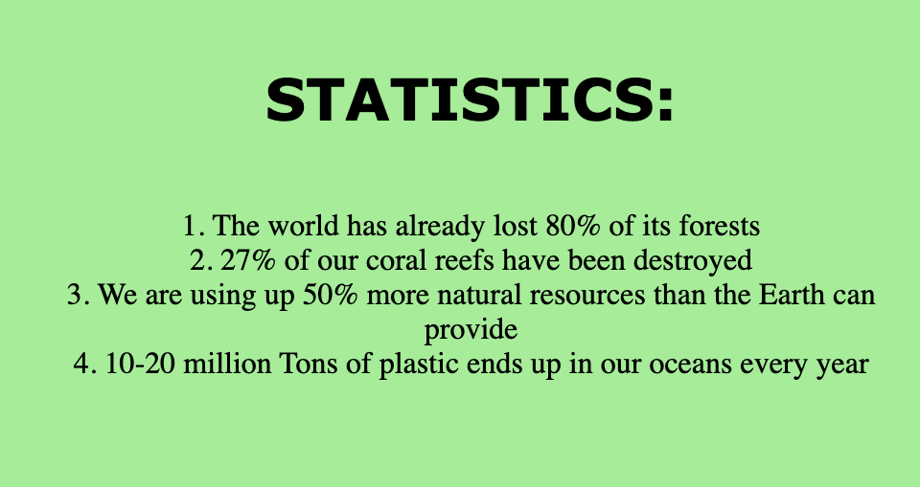
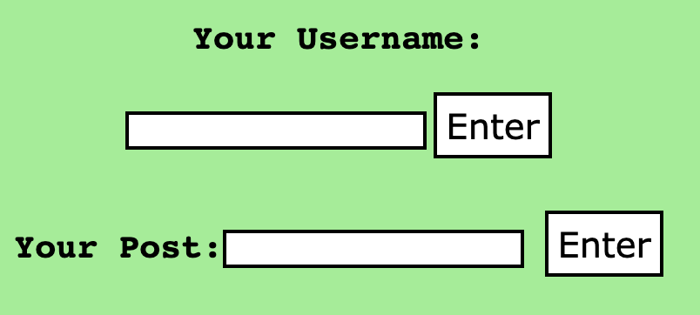
HTML Examples
Reference links
Lists
Buttons

Slide 7
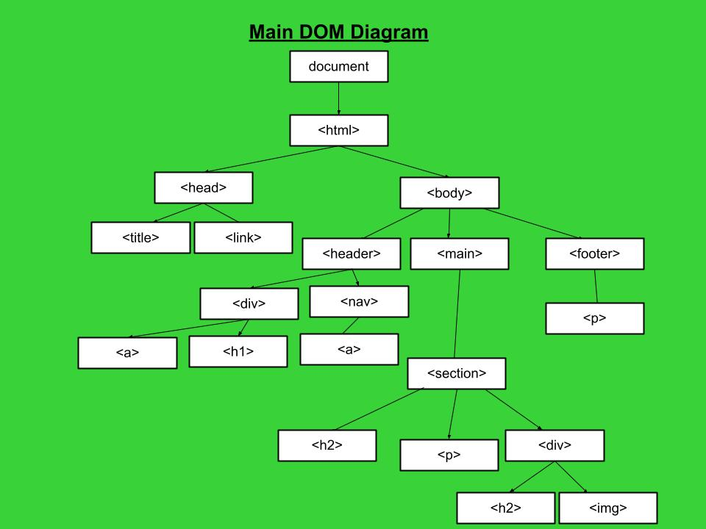
Main
DOM Diagram
This is the main structure of each html document aside from the Purchase page.
The Home, Donations, Information, and Spread The Word pages are all constructed similarly to this diagram.

Slide 8
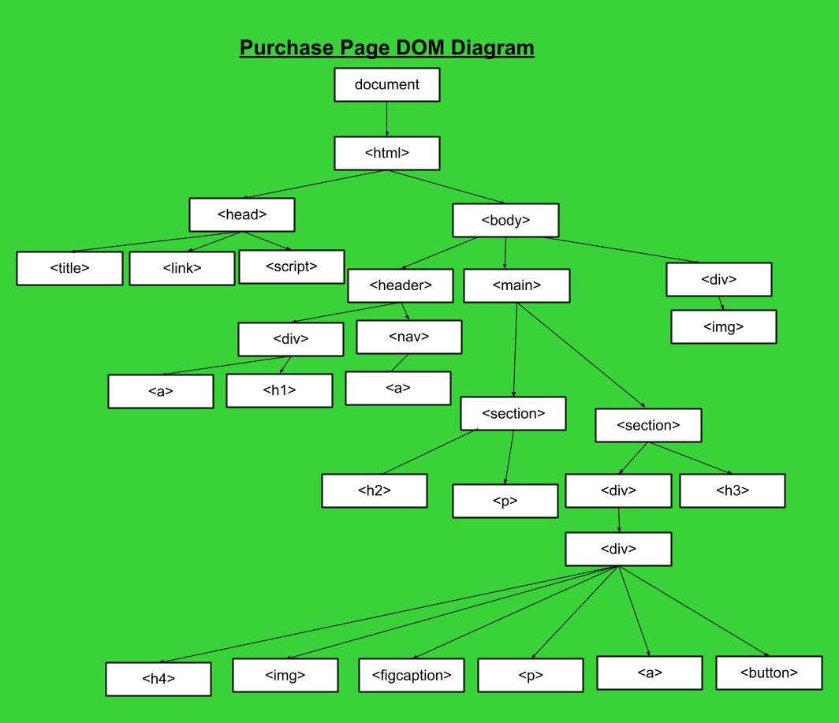
Purchase Page
DOM Diagram
For the Purchase page; however, the html structure begins to differ more so than its counterparts.
Each item has its own header, description, corresponding link and two buttons associated with either its price or the Wishlist.

Slide 9
CSS Used
On the Purchase Page, responsive CSS was used to change the number of items showed depending on the size of the screen. It goes from 4 elements on the largest screen to 1 element on a mobile screen.
This is done using a flexbox layout and changing the percentages for how much each box should fill in a row depending on the size of the screen.
Responsive CSS was also used on the donations and information pages to move the pictures into a better position for better readability.

Slide 10
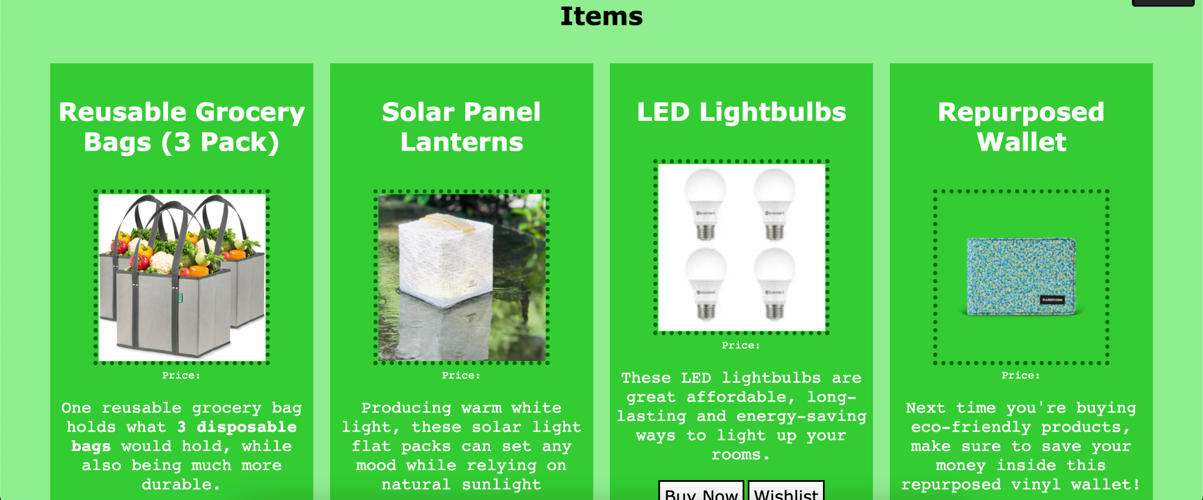

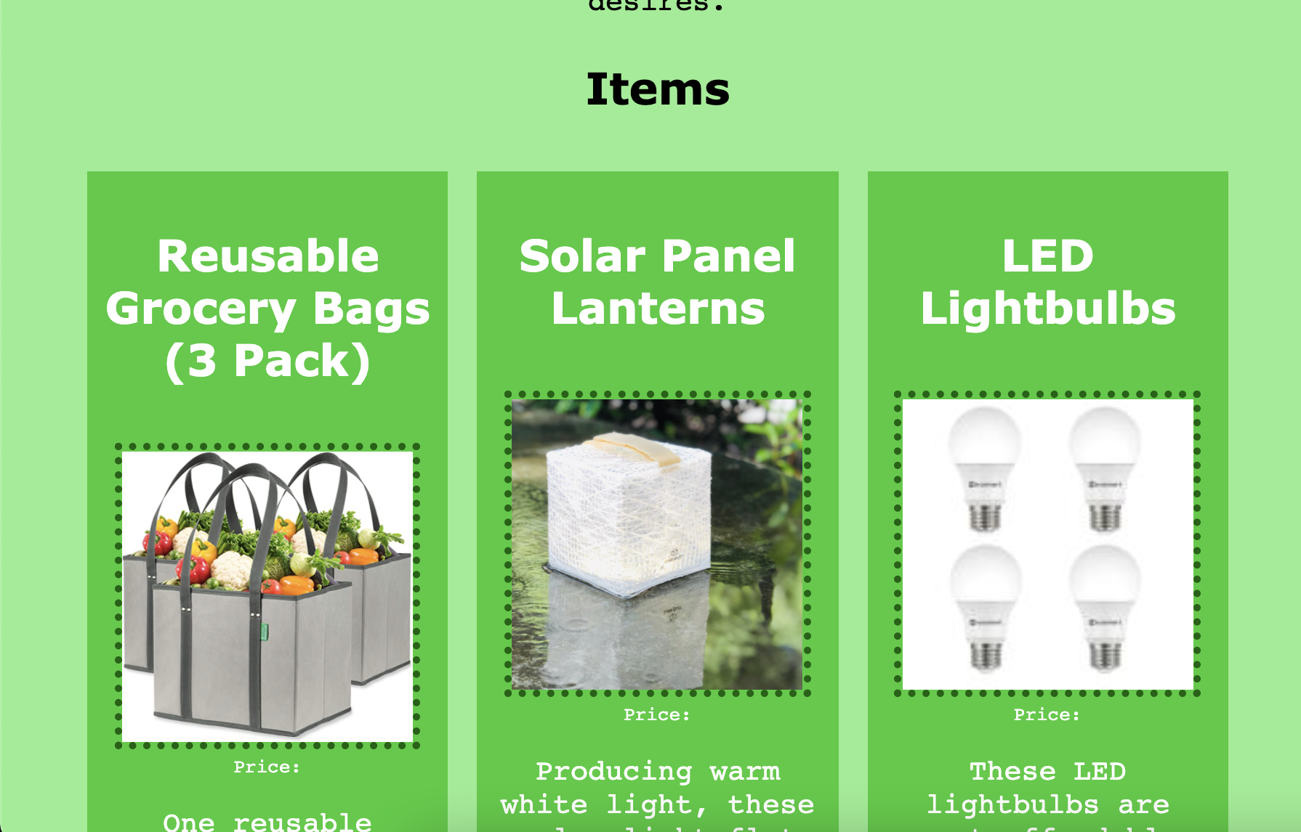
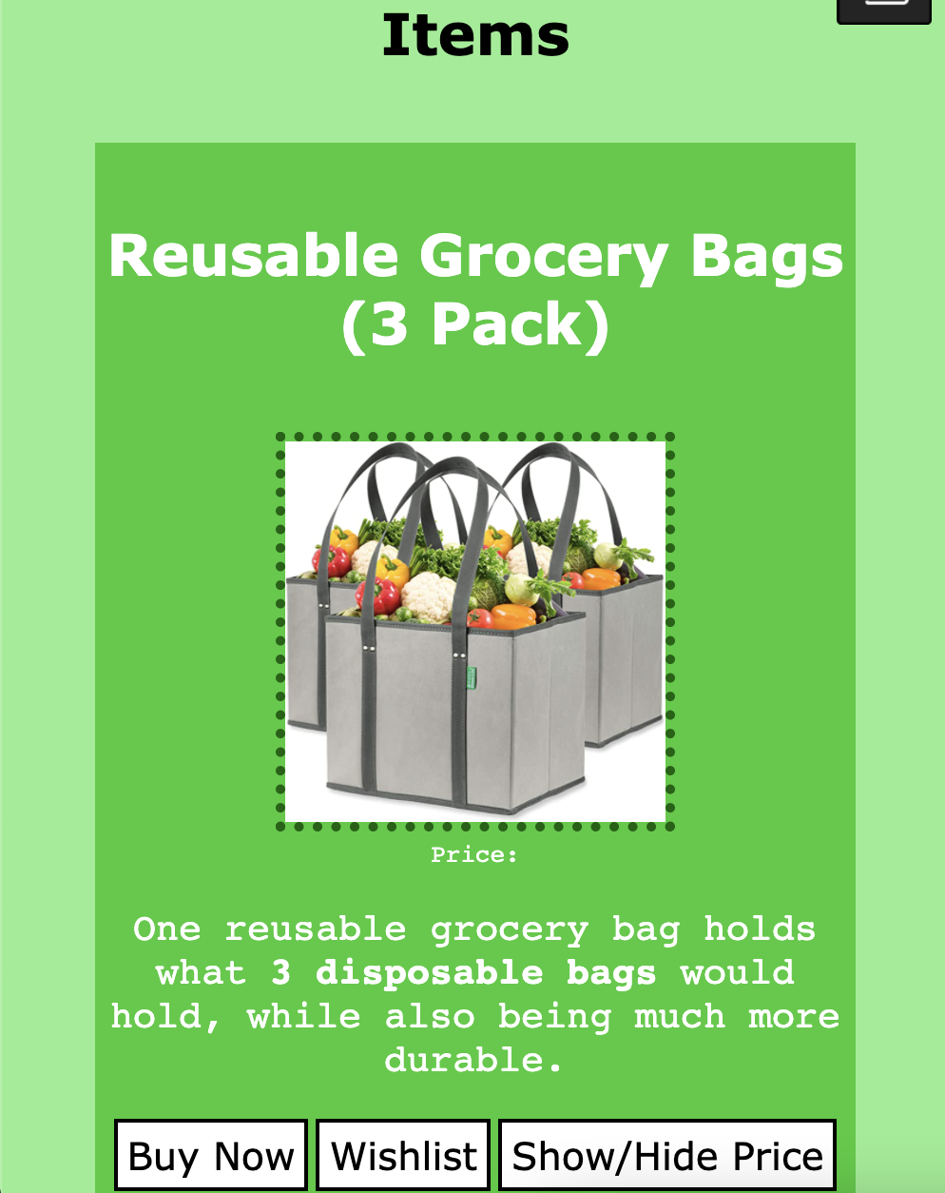

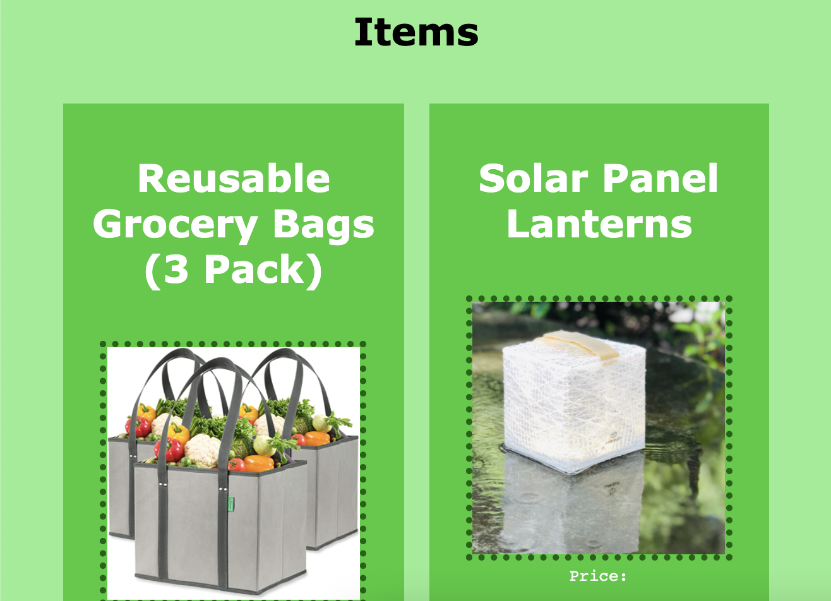
CSS Examples
Purchase Page
Donations Page

Slide 11
JS Functionality
Two Javascript functions work together to make the interactive Spread The Word page where users can enter a desired username and post a comment to the General Board.
Additionally, Javascript is used to implement the functions that toggle the price on the Purchase page. When clicked, the Show/Hide Price button calls the function, constructed with conditional terms, that makes each product’s price either appear or disappear
Finally, JS and JQuery play a large role in the Wishlist functionality. It’s composed of various functions, conditional statements and indexed arrays based on information found in the HTML of the Purchase page.

Slide 12
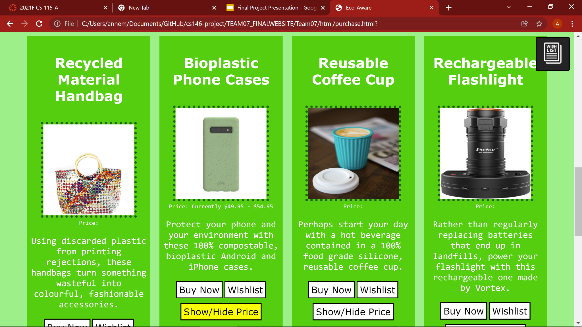
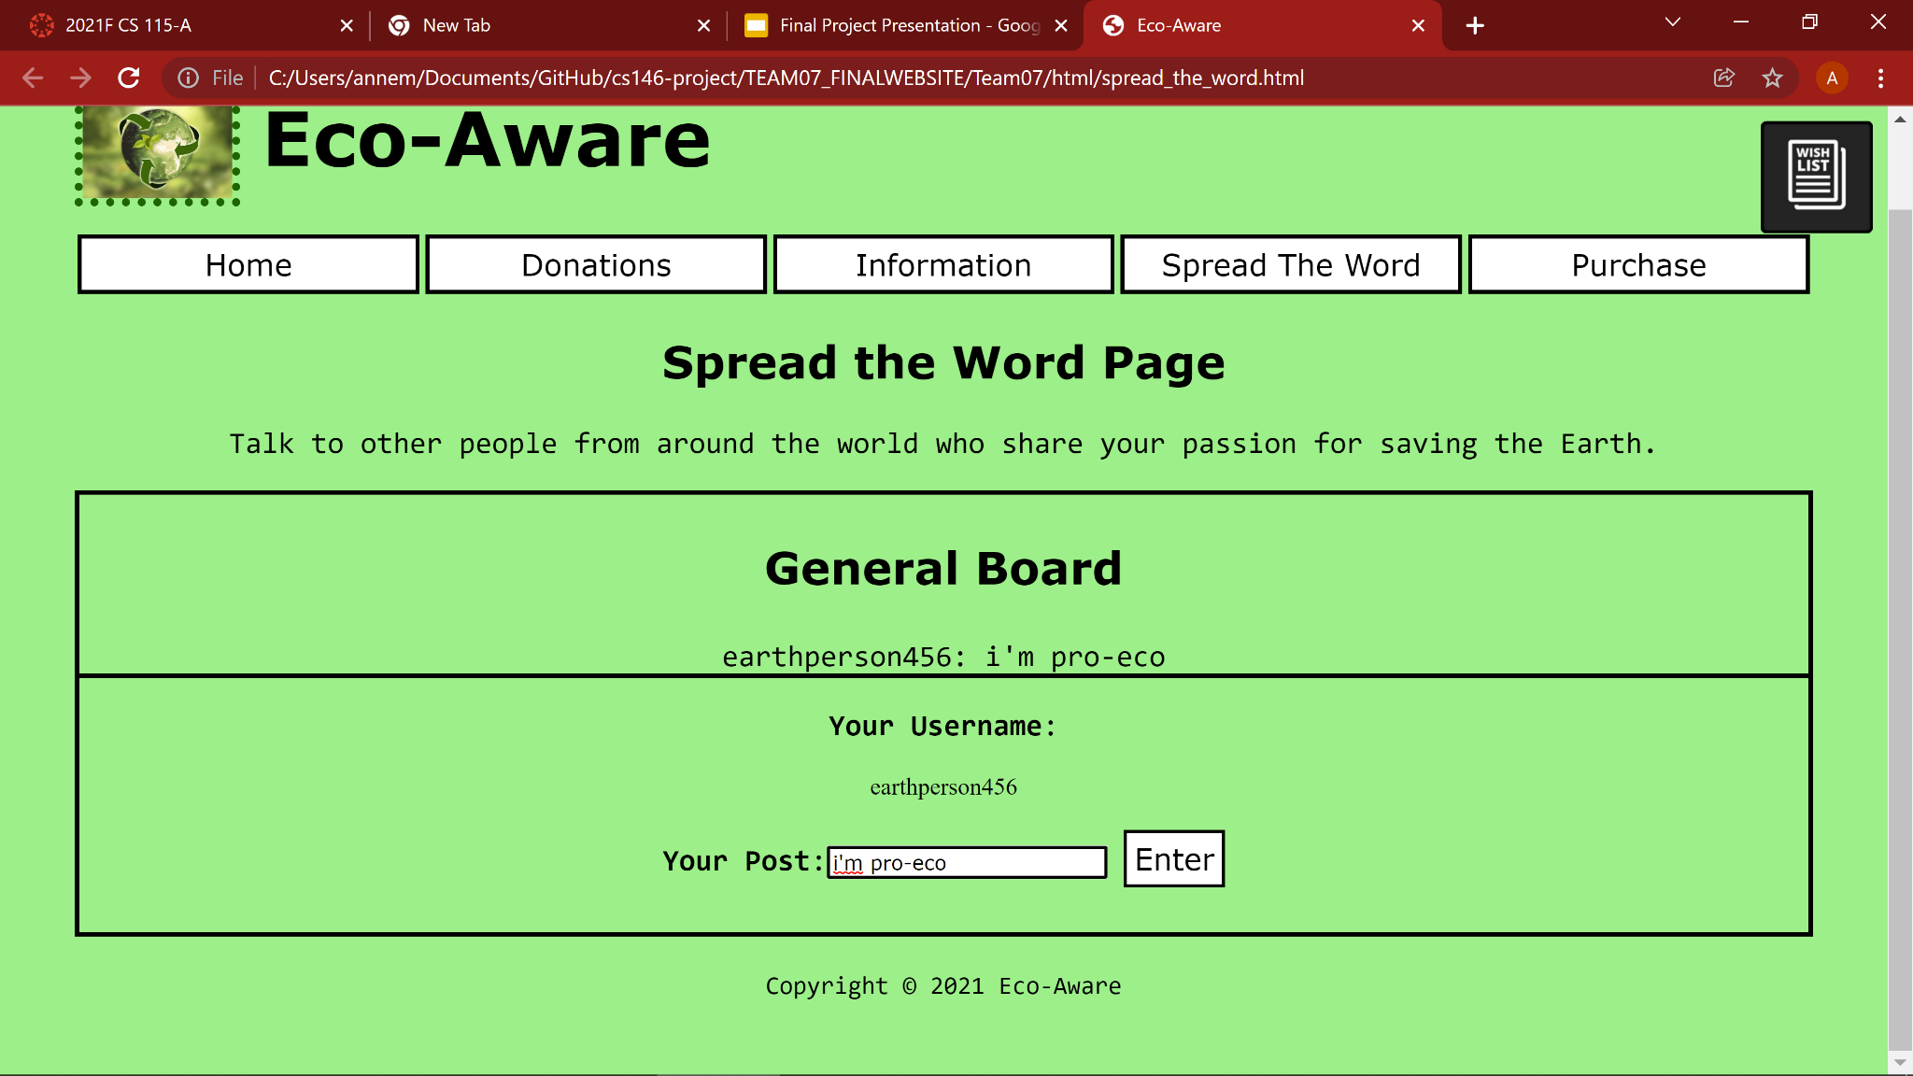
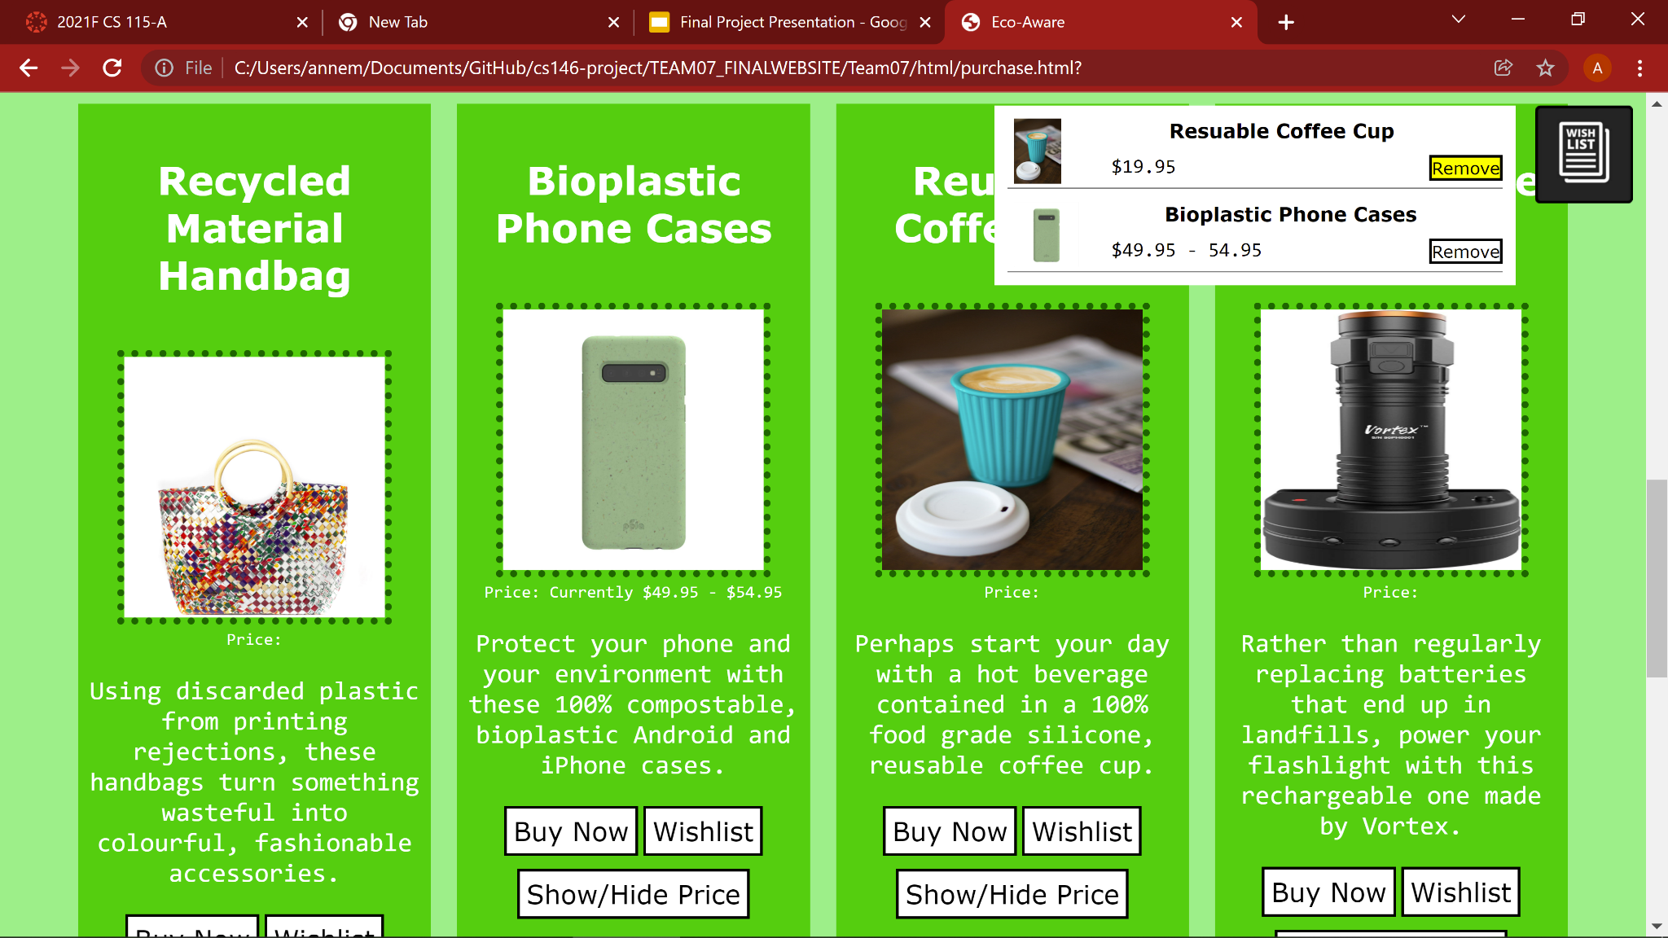
JS Examples
Toggling price
display
Adding comments
Adding/removing items from Wishlist

Slide 13
Contributions and Github Link
https://github.com/nicholas-buckley/cs146-project
Nicholas Buckley
Created Wishlist
Implemented Responsive Design on every page
HTML on Home and Spread the Word pages
Izabel Miminoshvili
Researched organizations that work to help the environment
HTML for the Donations page
CSS for the layout of each page such as the borders, colors, etc.
Andrew Donohue
Research/pictures for Information page
HTML on Information page
Javascript for Spread the Word page discussion board
Anne-Marie Akoh
Research on environmental products
HTML on Purchase page
Javascript for Show/Hide Price button

